Slide 1
Machine Learning In PHYsics FoundationS 1
Harrison B. Prosper
PHY6937 / PHY4936

Slide 2
Goals of this Course
Gain a good understanding of the mathematical basis of machine learning (ML).
Gain experience building ML models using PyTorch to solve data science problems in physics.
Gain experience with different ML models.
Gain an appreciation of the power of ML models as well as their (current) limitations.

Slide 3
Course Evaluation
In addition to your Course Participation (attending, asking questions, contributing to discussions), your course grade will be based on:
In-class Assignments
Project with a write-up and a brief presentation
Graduates: A project related to your research area.
Undergraduates: A project selected from a few options.
Presentations: Week 13, Nov. 18, 20, Dec. 2.
Grade: Graduates (S/U), Undergraduates (Letter Grade).

Slide 4
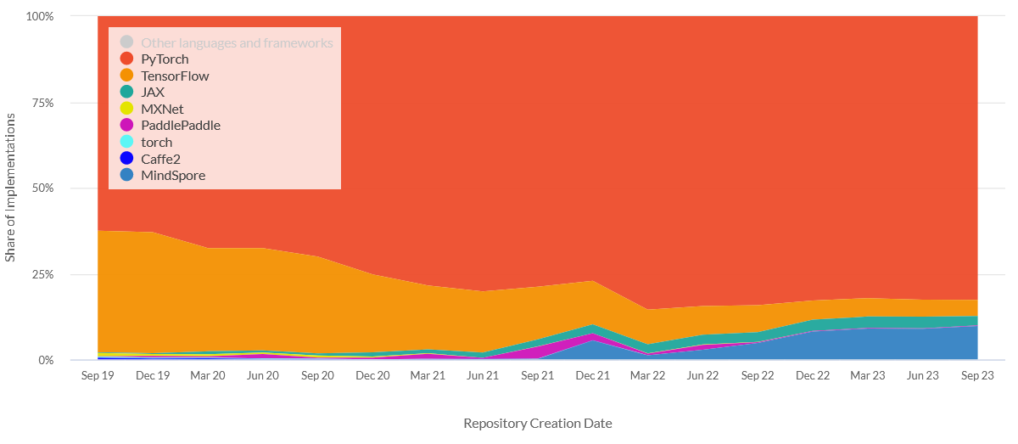
Why PyTorch?
80% of research-level AI development uses PyTorch (2025).
https://viso.ai/deep-learning/pytorch-vs-tensorflow/

Slide 5
What is Artificial Intelligence?
Artificial Intelligence
Algorithms that cause machines to exhibit human- or superhuman-level intelligence.

Slide 6
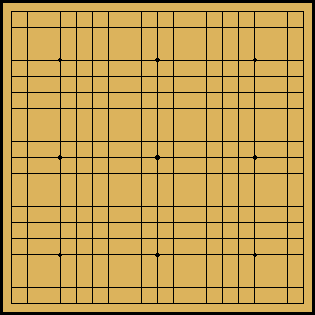
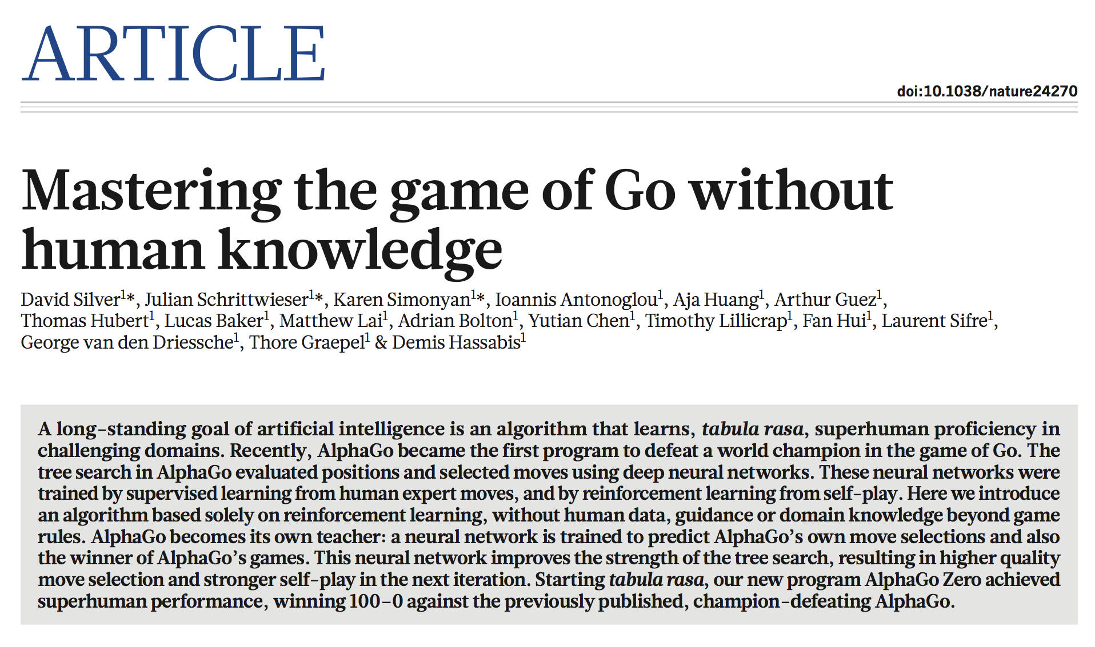
356 | NATURE | VOL 550 | 19 OCTOBER 2017

Slide 7
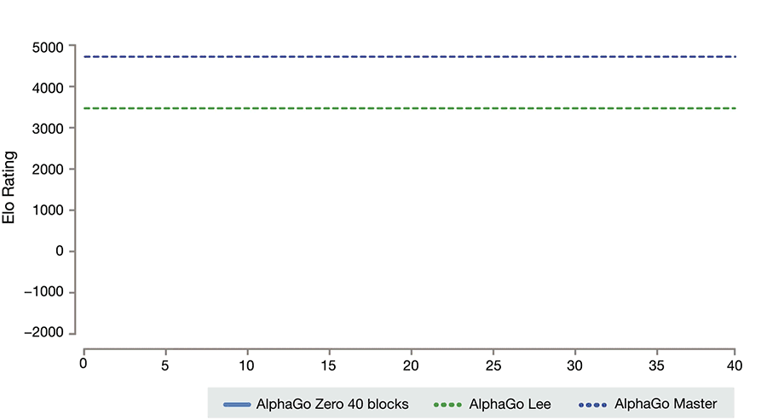
https://deepmind.com/blog/alphago-zero-learning-scratch/

Slide 8


Symbolic Mathematics
In December 2019, Guillaume Lample and François Charton* (Meta fka Facebook AI Research, Paris) claimed: “We achieve results that outperform commercial Computer Algebra Systems such as Matlab or Mathematica.”
* G. Lample and F. Charton, Deep Learning for Symbolic Mathematics, arXiv: 1912.01412v1
Lample
Charton

Slide 9
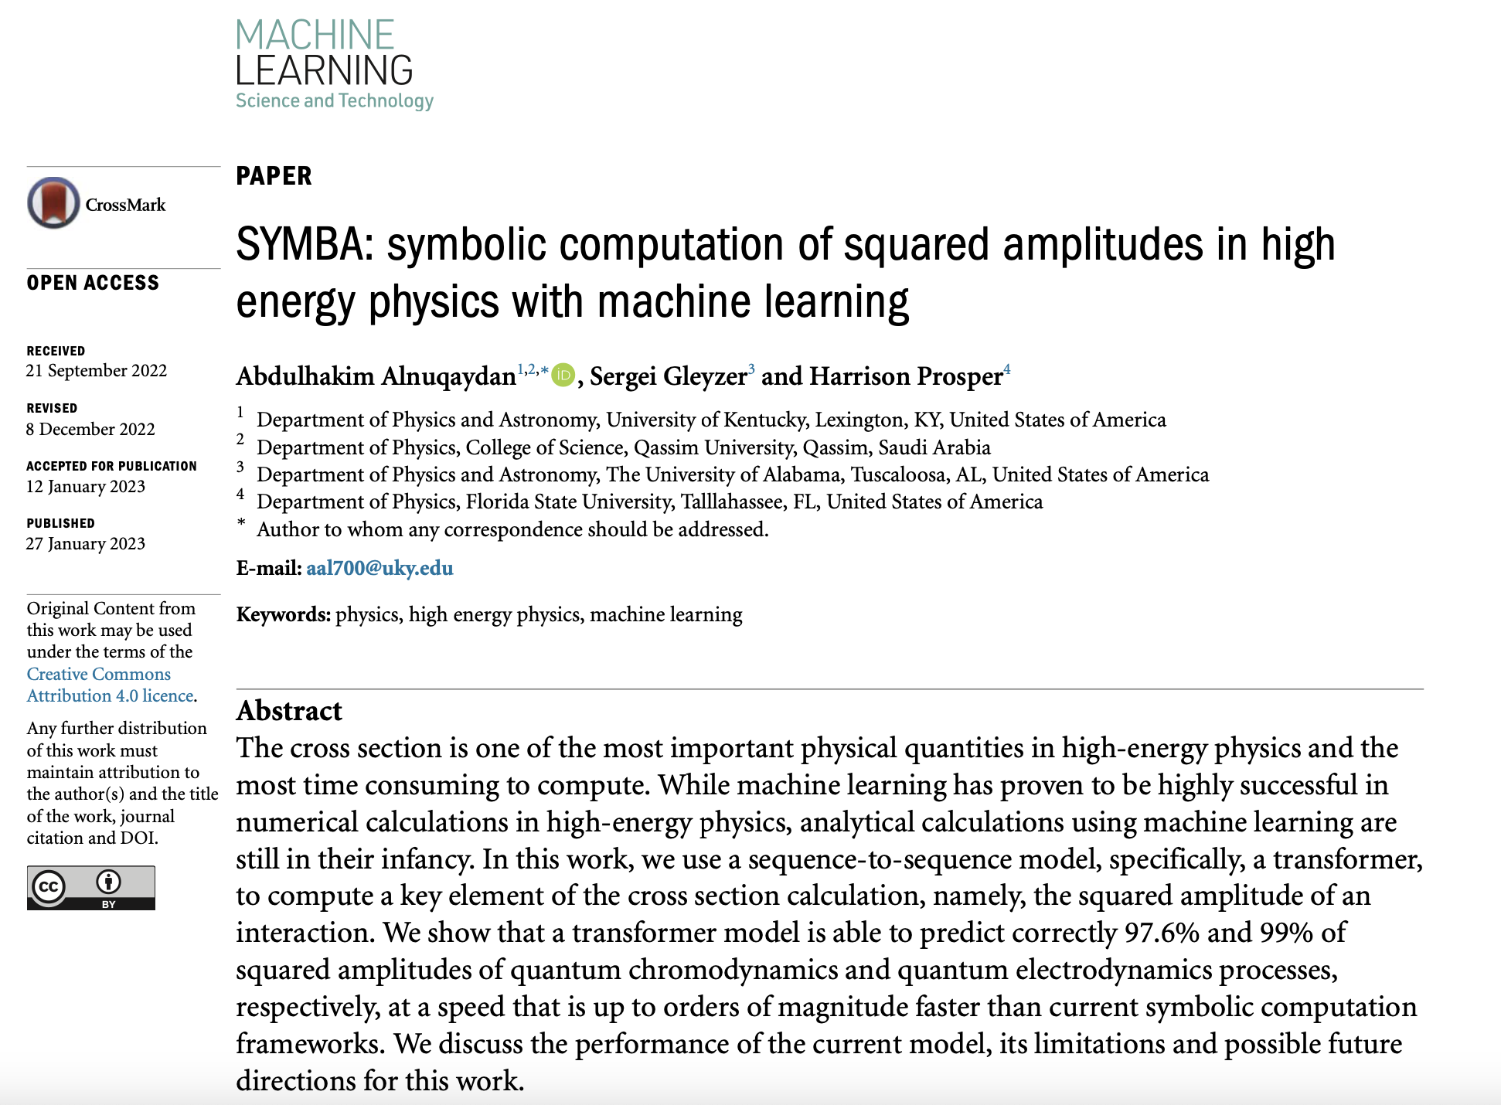

Slide 10
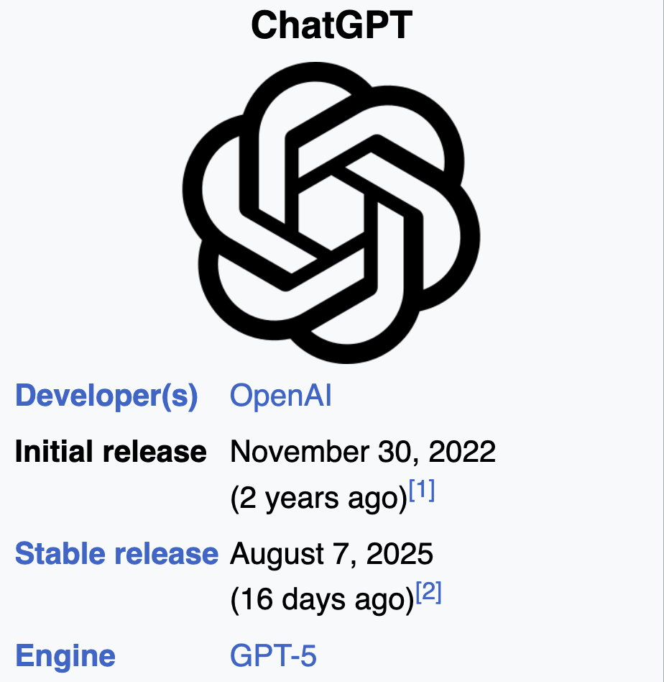

Slide 11
What is Machine Learning?
Artificial Intelligence
Algorithms that cause machines to exhibit human- or super-human level intelligence.
Machine Learning
Algorithms for modeling data.

Slide 12
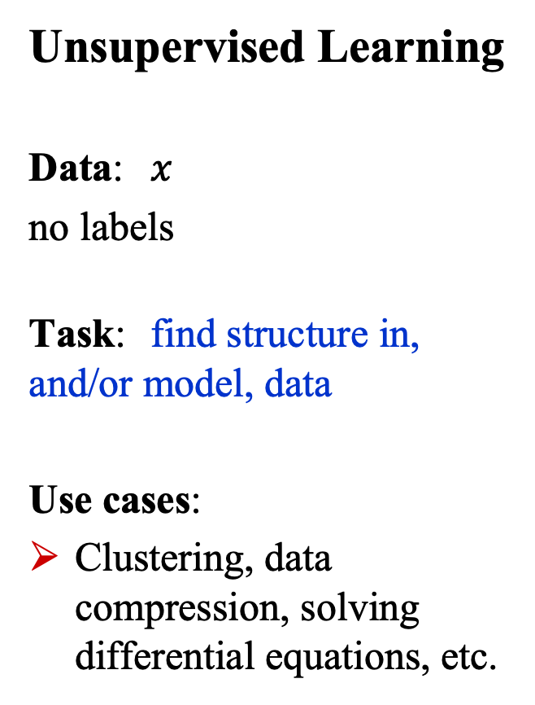
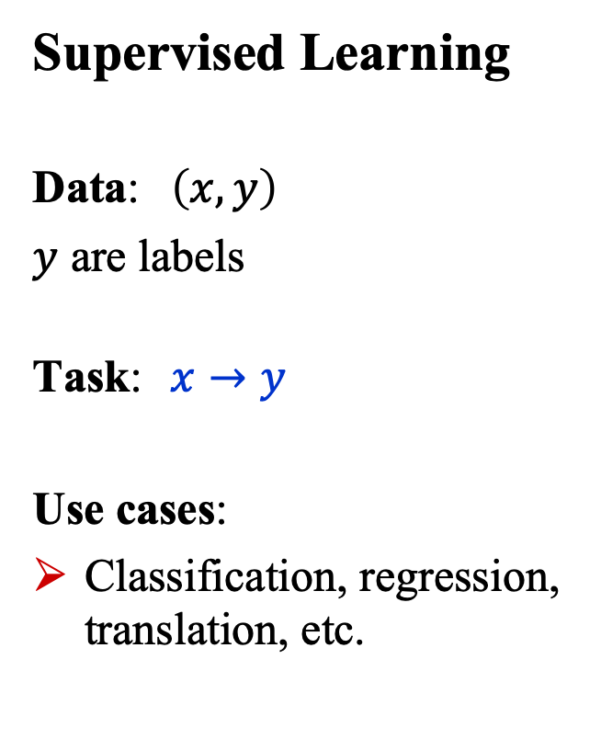
What is Machine Learning?
Supervised Learning
Data: $\left(x, y\right)$
$y$ are labels
Task: $x→y$
Use cases:
Classification, regression, translation, etc.
Unsupervised Learning
Data: $x$
no labels
Task: find structure in, and/or model, data
Use cases:
Clustering, data compression, solving differential equations, etc.

Slide 13
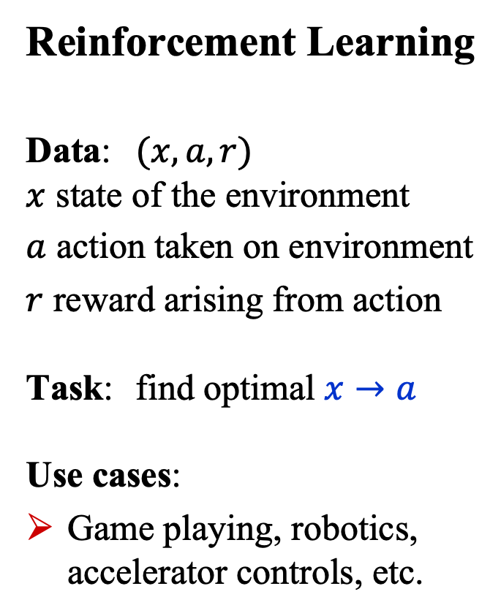
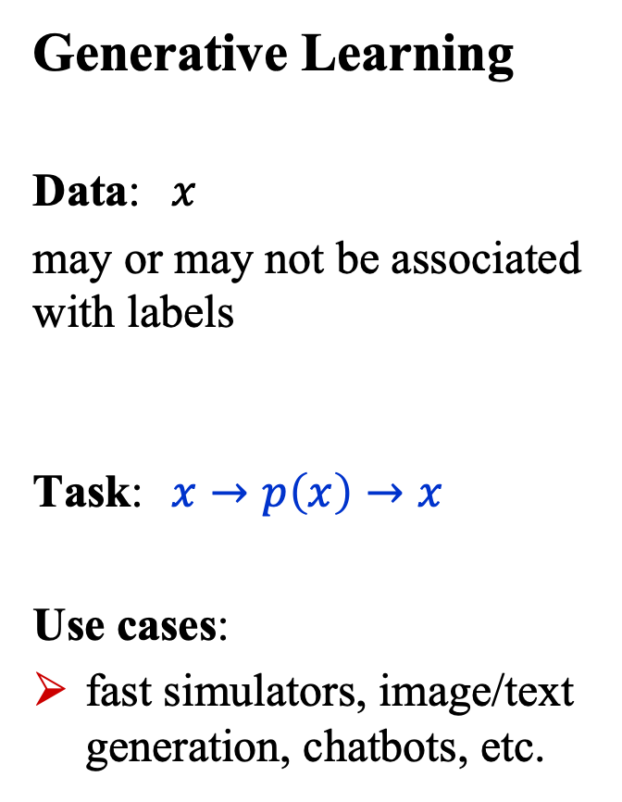
What is Machine Learning?
Generative Learning
Data: $x$
may or may not be associated with labels
Task: $x→p\left(x\right)→x$
Use cases:
fast simulators, image/text generation, chatbots, etc.
Reinforcement Learning
Data: $(x,a,r)$ $x$ state of the environment
$a$ action taken on environment
$r$ reward arising from action Task: find optimal $x→a$ Use cases:
Game playing, robotics, accelerator controls, etc.

Slide 14
What is Deep Learning?
Artificial Intelligence
Algorithms that cause machines to exhibit human- or super-human-level intelligence.
Machine Learning
Algorithms for modeling data
Deep Learning
ML using (large) neural networks

Slide 15
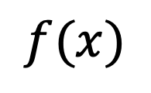
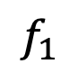
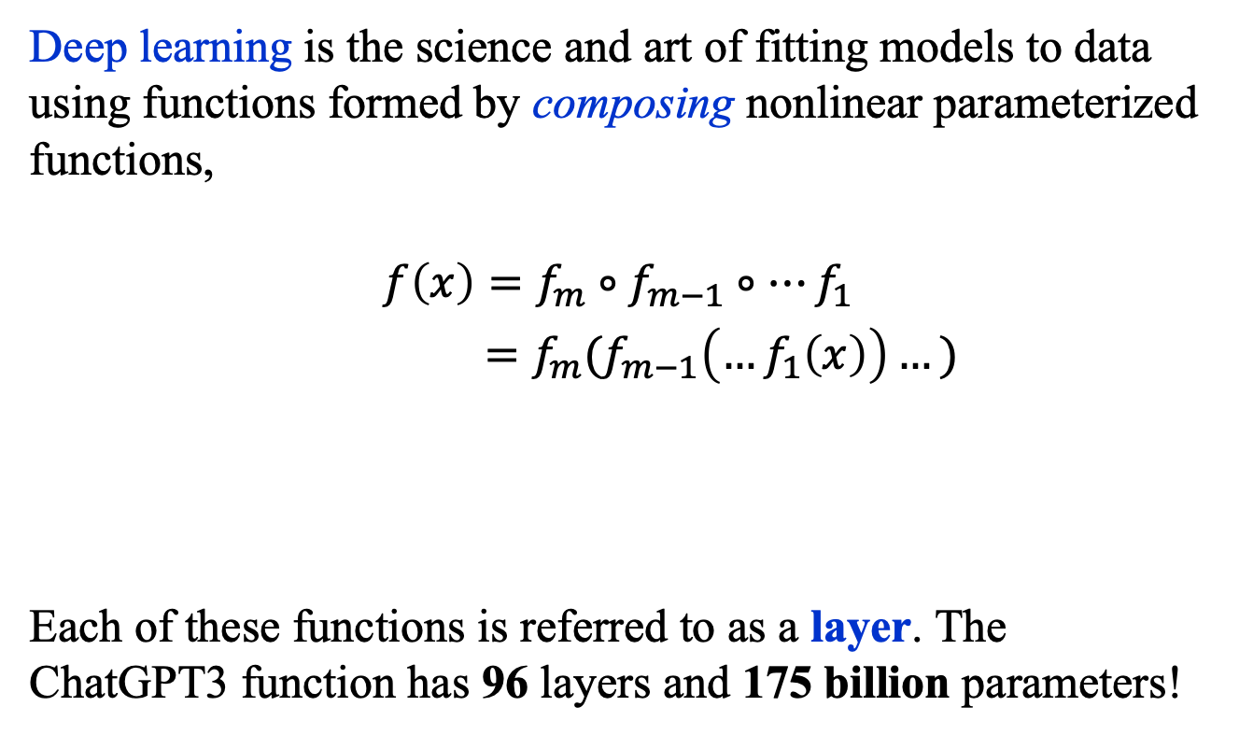
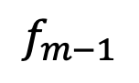
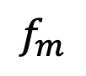

What is Deep Learning?
Deep learning is the science and art of fitting models to data using functions formed by composing nonlinear parameterized functions,
$$f\left(x\right)=f_{m}∘f_{m−1}∘…f_{1}$$
$=f_{m}(f_{m−1}\left(…f_{1}\left(x\right)\right)…)$
Each of these functions is referred to as a layer. The ChatGPT3 function has 96 layers and 175 billion parameters!
$$f(x)$$
…
$$x$$
$$f_{m}$$
$$f_{m−1}$$
$$f_{1}$$

Slide 16
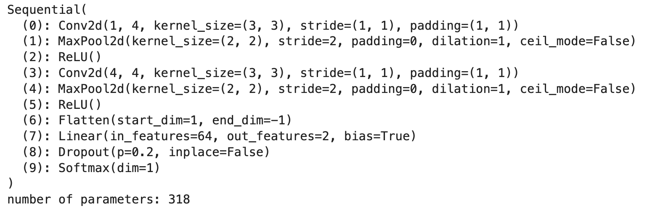
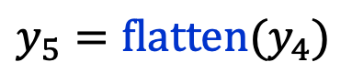
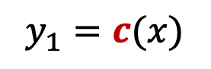
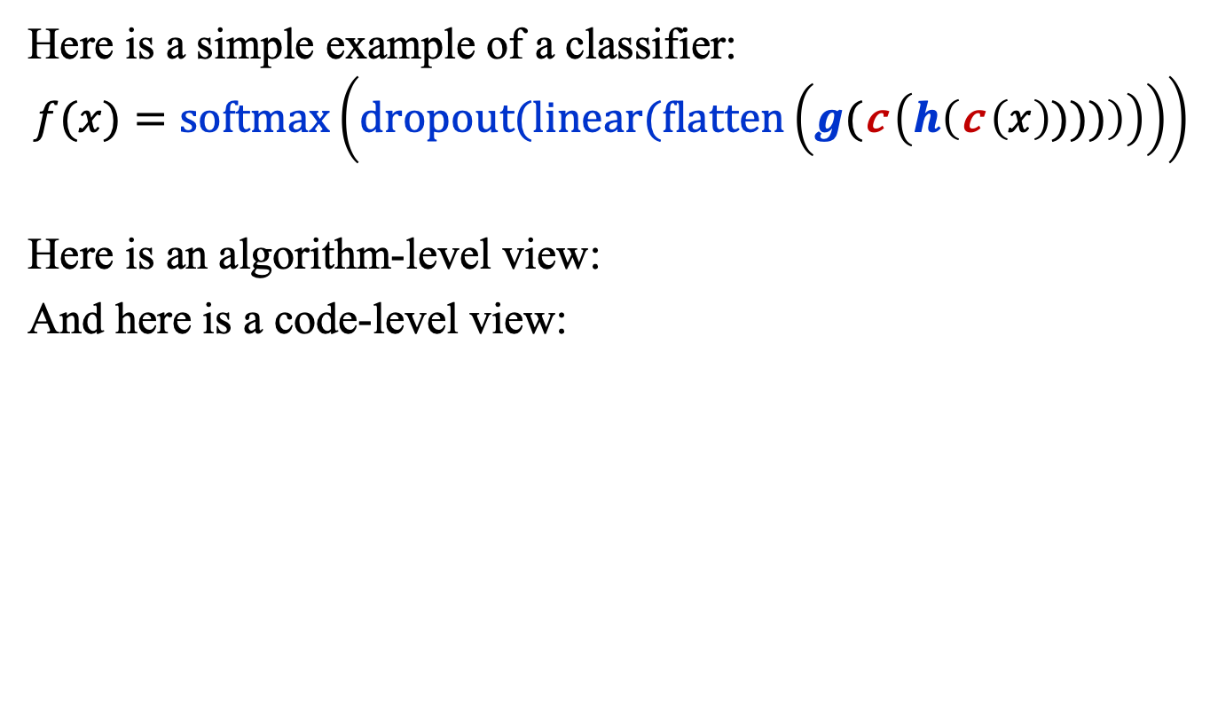
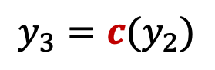
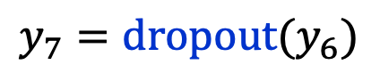
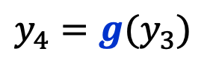
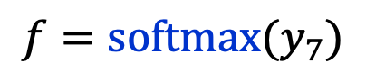
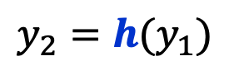
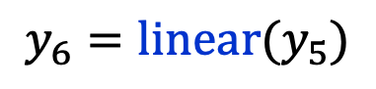
What is Deep Learning? Example
Here is a simple example of a classifier:
$$f(x)=\text{softmax}\left(dropout(linear(flatten\left(g(\text{c} \left(h\left(\text{c} \left(x\right))))\right)\right)\right)\right)$$
Here is an algorithm-level view:
And here is a code-level view:
$$y_{1}=c(x)$$
$$y_{5}=\text{flatten}(y_{4})$$
$$y_{2}=h(y_{1})$$
$$y_{6}=\text{linear}(y_{5})$$
$$y_{3}=c(y_{2})$$
$$y_{7}=\text{dropout}(y_{6})$$
$$y_{4}=g(y_{3})$$
$$f=\text{softmax}(y_{7})$$

Slide 17
Basic building block: The perceptron

Slide 18
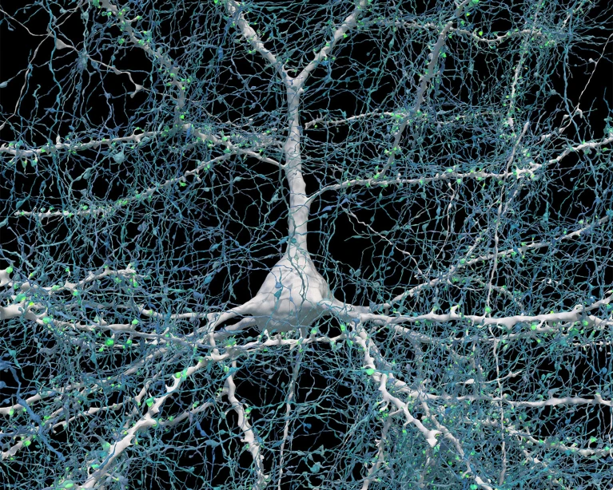
The Brain’s Computational Unit
https://www.nature.com/articles/d41586-024-01387-9

Slide 19
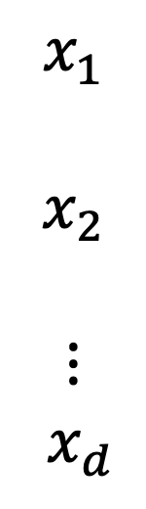
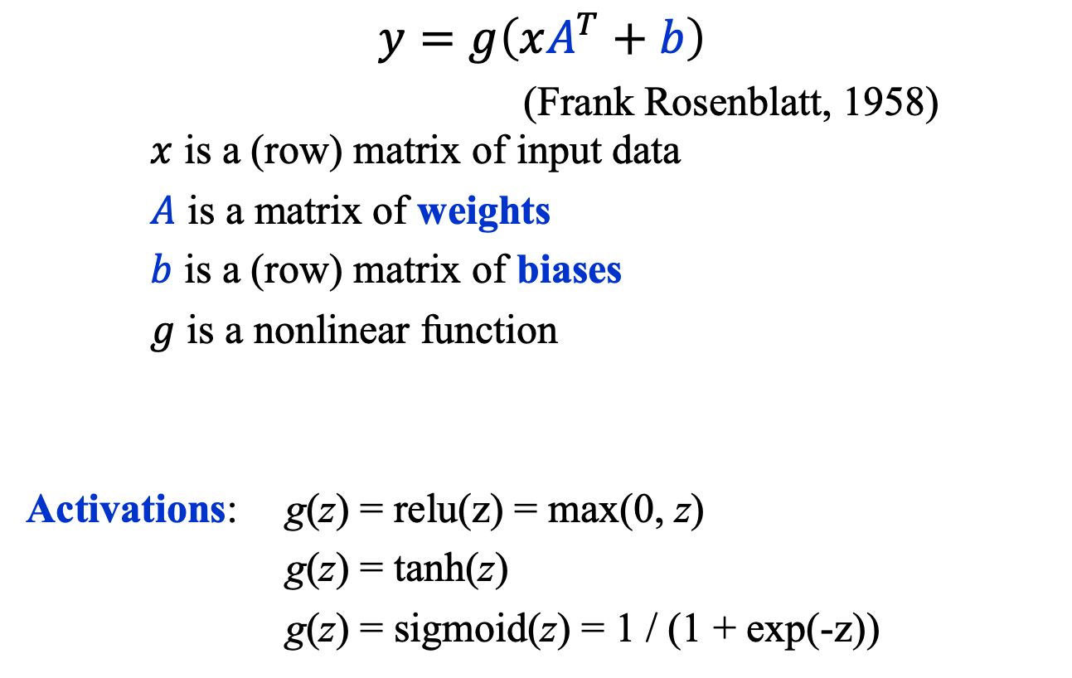

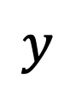
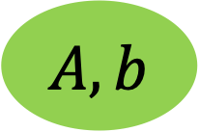
Basic AI Comp. Unit: The Perceptron
$$y=g\left(xA^{T}+b\right)$$
(Frank Rosenblatt, 1958) $x$ is a (row) matrix of input data
$A$ is a matrix of weights
$b$ is a (row) matrix of biases
$g$ is a nonlinear function
Activations: g(z) = relu(z) = max(0, z)
g(z) = tanh(z)
g(z) = sigmoid(z) = 1 / (1 + exp(-z))
$$x_{1}$$
$$x_{2}$$
$$⋮$$
$${ x}_{d}$$
$$y$$
$$g$$
$$A, b$$
https://news.cornell.edu/stories/2019/09/professors-perceptron-paved-way-ai-60-years-too-soon

Slide 20
Multi-Node perceptron

Slide 21
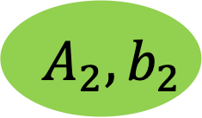
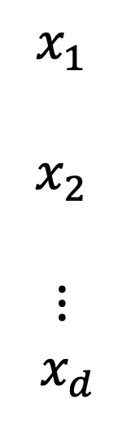
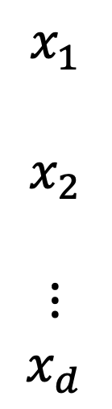
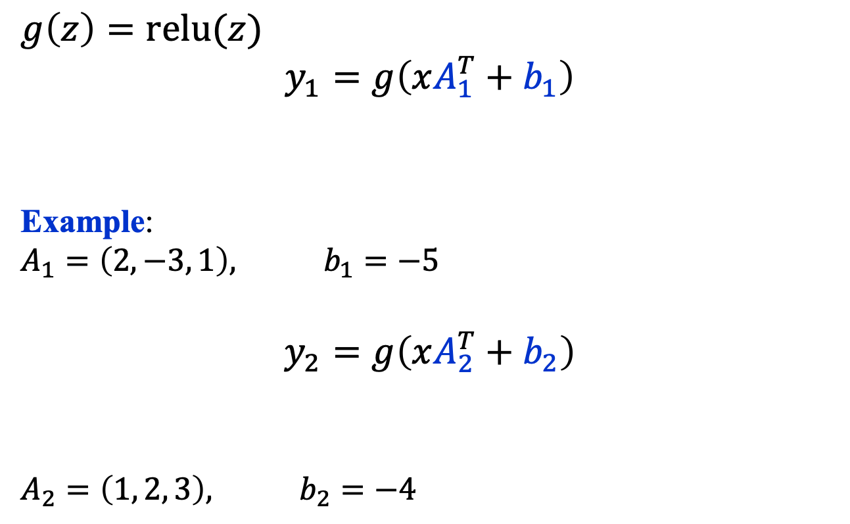

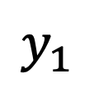

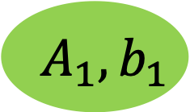
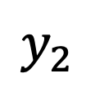
Multi-Node Perceptron
$$x_{1}$$
$$x_{2}$$
$$⋮$$
$${ x}_{d}$$
$$g\left(z\right)=\text{relu}(z)$$
$$y_{1}=g\left(xA_{1}^{T}+b_{1}\right)$$
Example:
$$A_{1}=\left(2,−3, 1\right), b_{1}=−5$$
$$y_{2}=g\left(xA_{2}^{T}+b_{2}\right)$$
$$A_{2}=\left(1, 2, 3\right), b_{2}=−4$$
$$y_{1}$$
$$g$$
$$A_{1}, b_{1}$$
$$x_{1}$$
$$x_{2}$$
$$⋮$$
$x_{d}$
$$y_{2}$$
$$g$$
$$A_{2}, b_{2}$$

Slide 22
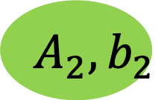
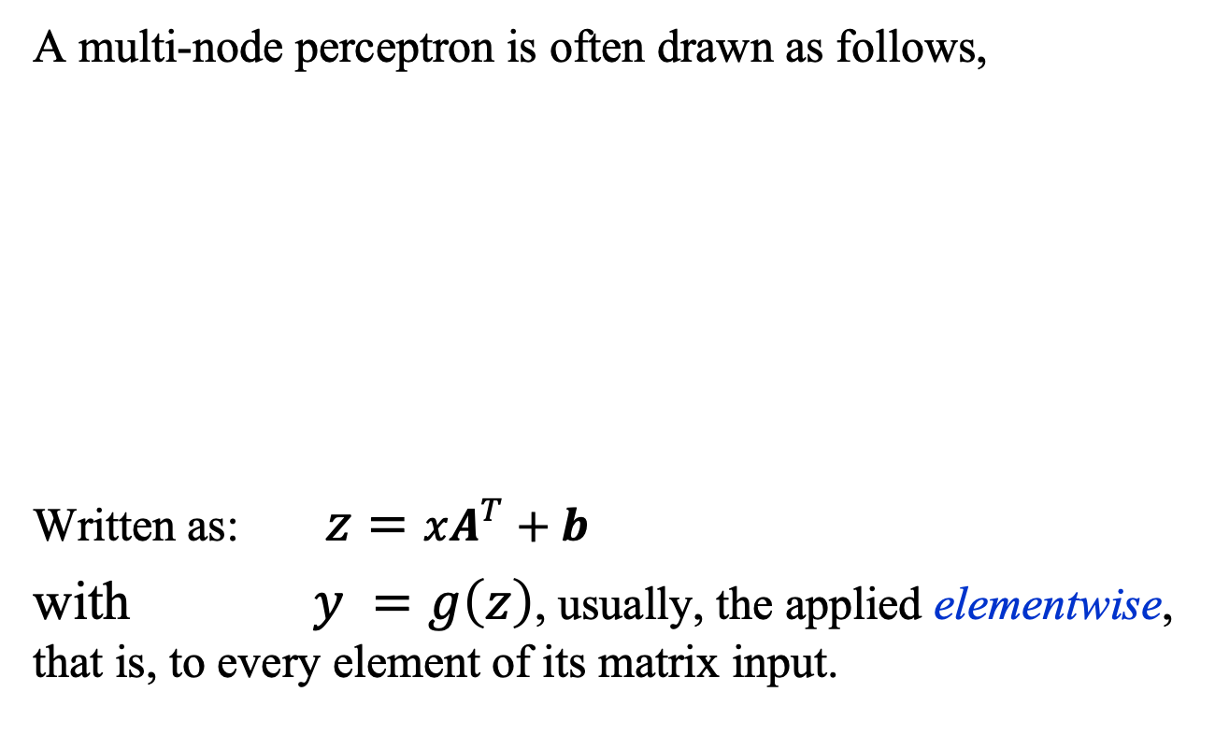

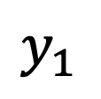
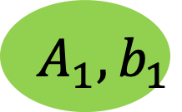

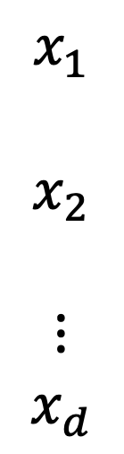
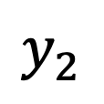
Multi-Node Perceptron
A multi-node perceptron is often drawn as follows,
Written as: $z=xA^{T}+b$
with $y =g\left(z\right)$, usually, the applied elementwise, that is, to every element of its matrix input.
$$x_{1}$$
$$x_{2}$$
$$⋮$$
$$x_{d}$$
$$y_{1}$$
$$g$$
$$A_{1}, b_{1}$$
$$y_{2}$$
$$g$$
$$A_{2}, b_{2}$$

Slide 23
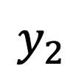
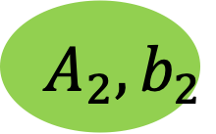
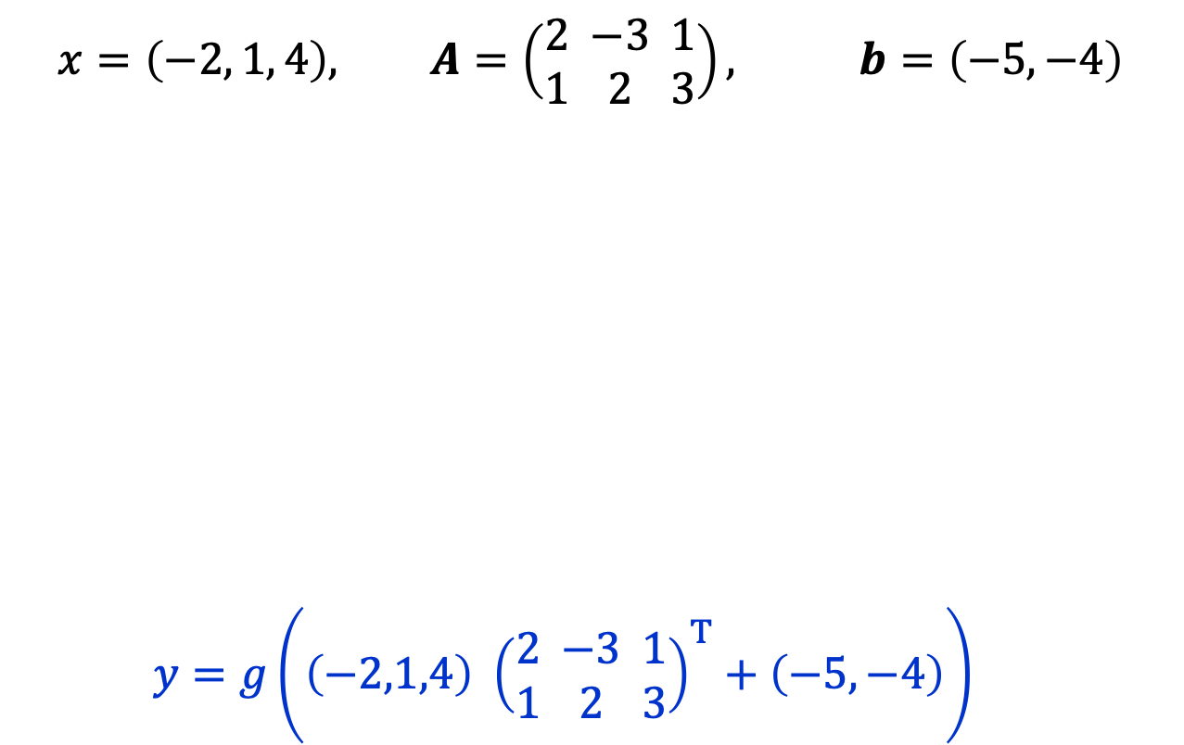

Multi-Node Perceptron: Example
$$x=\left(−2, 1, 4\right), A=\left(\begin{matrix}2 \\ 1\end{matrix}\begin{matrix} −3 \\ 2\end{matrix}\begin{matrix}1 \\ 3\end{matrix}\right), b=\left(−5,−4\right)$$
$y=g\left(\left(−2,1,4\right) {\left(\begin{matrix}2 \\ 1\end{matrix}\begin{matrix} −3 \\ 2\end{matrix}\begin{matrix}1 \\ 3\end{matrix}\right)}^{T}+\left(−5,−4\right)\right)$
$$x_{1}$$
$$x_{2}$$
$$⋮$$
$$x_{d}$$
$$y_{1}$$
$$g$$
$$A_{1}, b_{1}$$
$$y_{2}$$
$$g$$
$$A_{2}, b_{2}$$

Slide 24
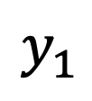
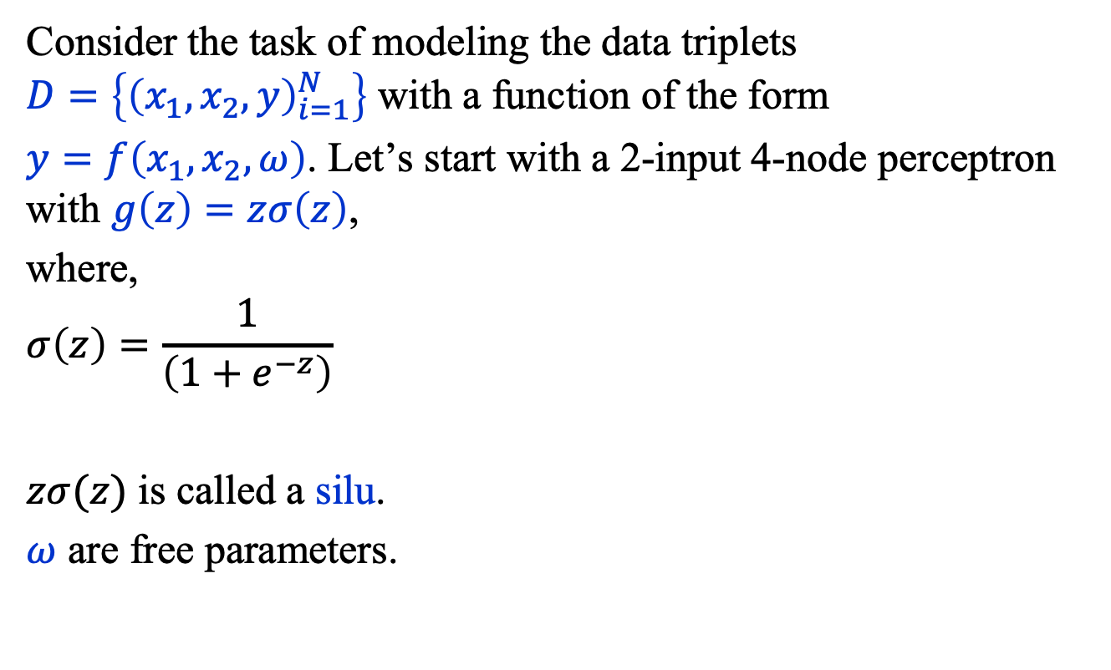
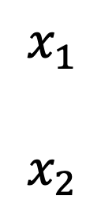

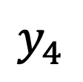




Multi-Node Perceptron
Consider the task of modeling the data triplets $D=\left\{{\left(x_{1},x_{2},y\right)}_{i=1}^{N}\right\}$ with a function of the form
$y=f\left(x_{1},x_{2},ω\right)$. Let’s start with a 2-input 4-node perceptron with $g\left(z\right)=zσ\left(z\right)$,
where,
$$σ\left(z\right)=\frac{1}{\left(1+e^{−z}\right)}$$
$zσ(z)$ is called a silu.
$ω$ are free parameters.
$$y_{1}$$
$$y_{2}$$
$$x_{1}$$
$$x_{2}$$
$$y_{3}$$
$$y_{4}$$
$$g$$
$$A, b$$
$$≡$$

Slide 25




Multi-Node Perceptron
Then, we feed the outputs of the 4-output perceptron into one with 4 inputs 1 node:
Layer 2
Layer 1
$$y_{1}$$
$$y=f\left(x_{1}, x_{2}, ω\right)$$
$$y_{2}$$
$$x_{1}$$
$$x_{2}$$
$$y_{3}$$
$$y_{4}$$
$$g$$
$$A, b$$
$$≡$$

Slide 26




Multi-Node Perceptron
Given the complexity of ML models (i.e., ML functions), it is now common to use a graphical representation that uses higher-level components. For example,
$f\left(z\right)=zA^{T}+b$
$g(z)=\text{relu}\left(z\right)$
$σ(z)={\left(1+e^{−z}\right)}^{−1}$
output
$$σ(z)$$
Layer 2
Linear(4, 1)
$$\text{relu}(z)$$
Layer 1
Linear(2, 4)
$$x$$

Slide 27

Multi-Node Perceptron
Here, for example, is high-level graphical representation of a transformer, the model that powers ChatGPT.
In ChatGPT 3, there are 96 layers with the same architecture, an instance of which is depicted as the two vertical grey boxes.
(Notice, the color-coding differs from ours!)

Slide 28
Summary
General Approaches
Supervised, unsupervised, generative, and reinforcement learning.
Deep Learning
Uses functions constructed through deep composition.
The Perceptron
Basic computational unit: matrix multiplication and addition followed by a nonlinear map.
We described the multi-node perceptron and how machine learning models are represented graphically.

